Slide 1



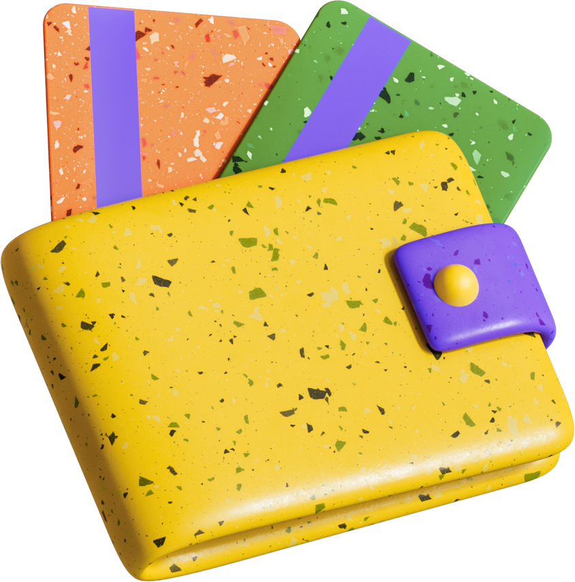














Tiba Store
Business project
Click Creators
Omar Abdelhady
Elsayed Hassan
Mahmoud Atef
Ahmed Reda

Slide 2
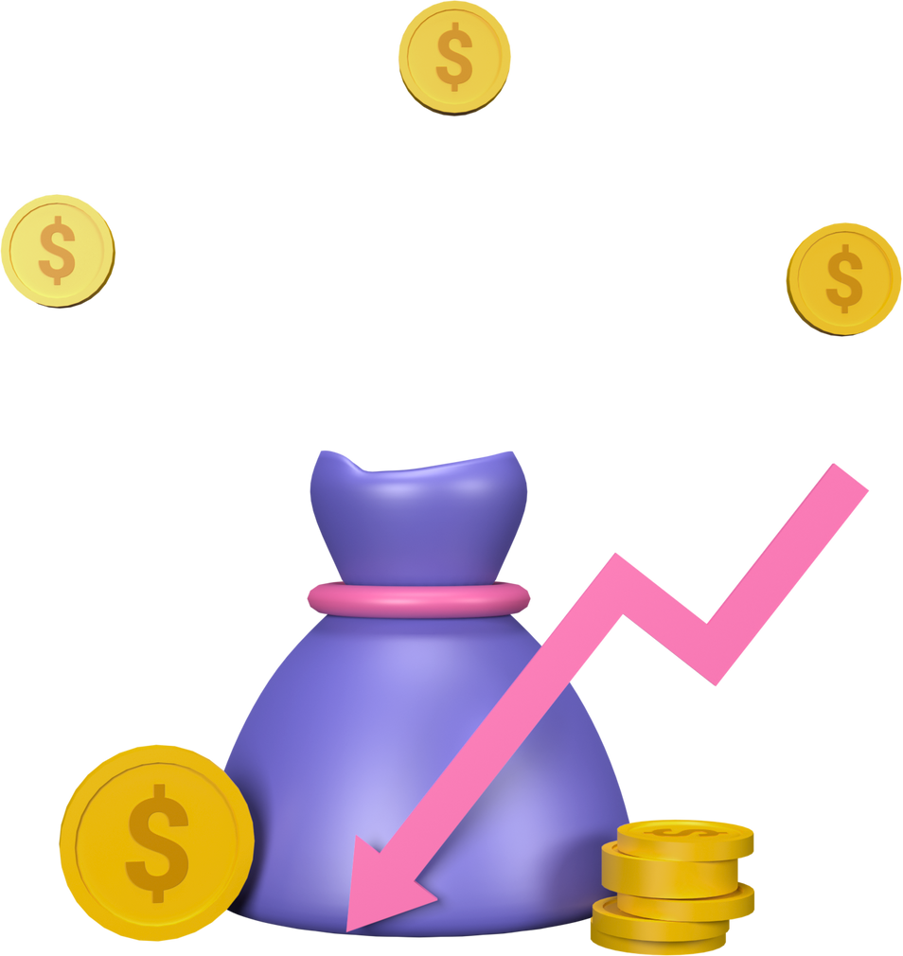
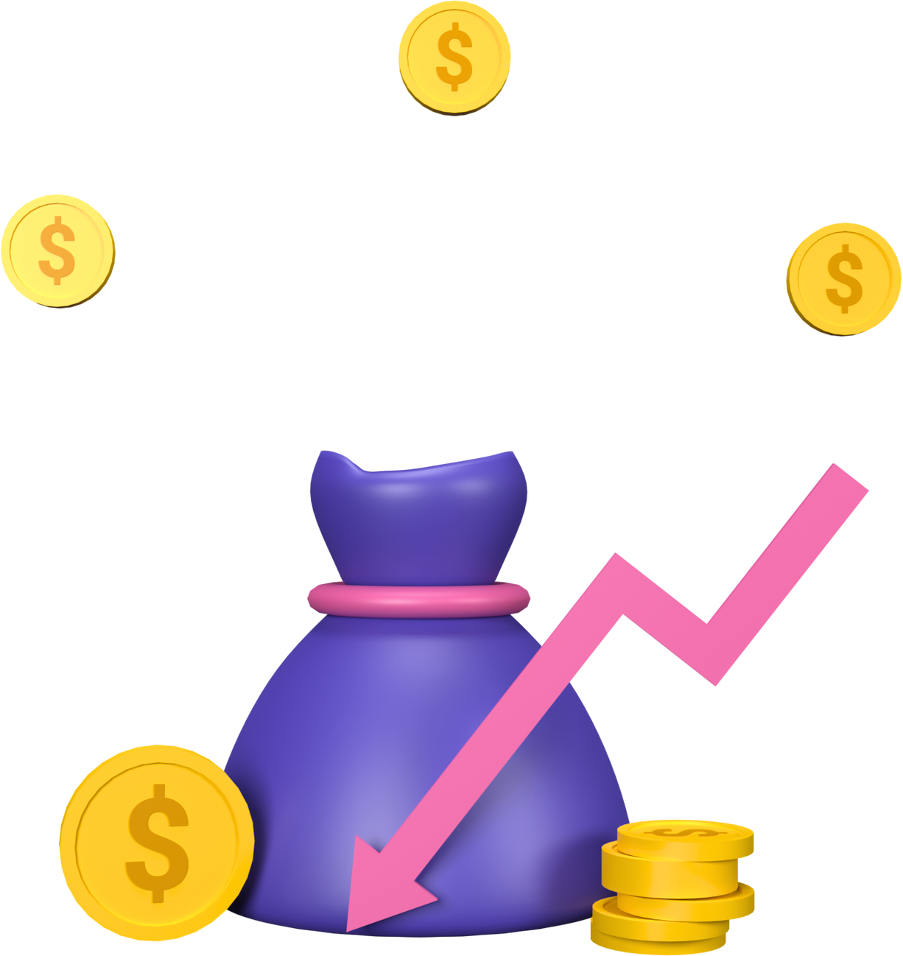

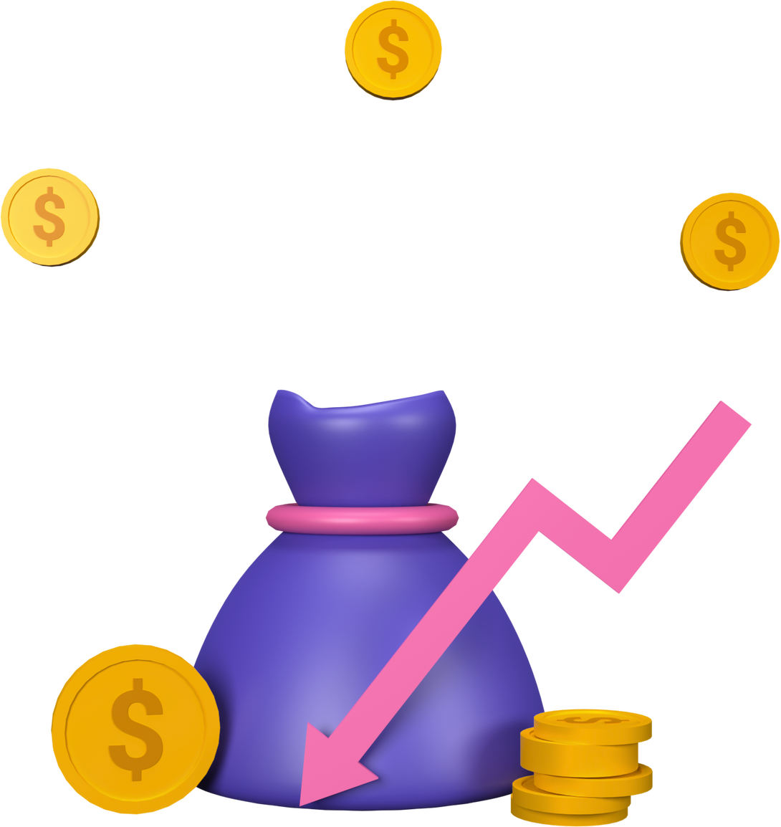
Project idea
Tiba Store is an Egyptian store offering a diverse range of high-quality beauty, cleaning, and baby care products at affordable prices.
Located in Banha, the store serves customers through both its physical store and online shop, providing a convenient and efficient shopping experience.
What sets Tiba Store apart is its reliance on a local digital experience, enabling same-day delivery within Banha, with direct communication via social media and WhatsApp.
The store also offers helpful educational content on home care, beauty, and childcare, adding real value to its customers beyond the purchase itself.
Tiba Store – The best for your family every day.

Slide 3





Vision & Business Goals
Vision
Tiba Store aims to be the premier destination for residents of Banha for high-quality home care, beauty, and baby products, offering a convenient shopping experience.
Tiba Store focuses on providing a seamless local digital experience that combines online shopping with direct customer service via social media and a dedicated Banha WhatsApp group, ensuring safe and reliable products at affordable prices and delivered on time.
Business Goals
Increase brand awareness in Banha: Enhance Tiba Store's presence across digital and social platforms to boost its reputation and build trust within the local community.
Attract and retain customers: Continuously engage with Banha residents through digital channels and offer them tailored deals and services.
Grow local sales: Achieve significant growth in demand and sales within the city by improving the shopping experience and providing fast delivery.
Build community loyalty: Foster a sense of belonging to Taiba Store as a trusted local brand that meets the needs of Banha families and adds real value to their lives.

Slide 4

Services Offered
Shopping via Social Media: Taiba Store allows customers to easily order their products through direct messages, including:
• Beauty and skincare products (shampoos, creams, perfumes)
• Household cleaning products (cleaners, sanitizers, air fresheners)
• Baby care products (gentle shampoos, lotions, wet wipes)
Local Digital Marketing: Managing Facebook and Instagram pages, creating engaging content, and implementing targeted advertising campaigns for Banha residents to increase awareness and sales.
Campaign Management and Performance Analysis: Monitoring engagement and measuring results to improve performance and enhance customer satisfaction.
Taiba Store focuses on providing a fast and reliable local shopping experience that combines quality and effective communication to best serve the residents of Banha.

Slide 5




Unique Selling Point (USP)
What truly sets Tiba Store apart is its focus on trusted local family needs. All products are carefully selected to ensure safety, quality, and everyday convenience for every member of the Banha family.
Unlike other stores that focus on a single product category, Tiba Store brings together beauty, baby care, and household cleaning products in one reliable location.
The store relies on direct communication with customers via WhatsApp, Facebook, Instagram, and Telegram to quickly meet their needs, offering competitive prices and exceptional customer service that fosters trust and a sense of community within Banha.
With this approach, Tiba Store offers a combination of local convenience, reliable quality, and modern digital service, making it the ideal choice for Banha families.

Slide 6
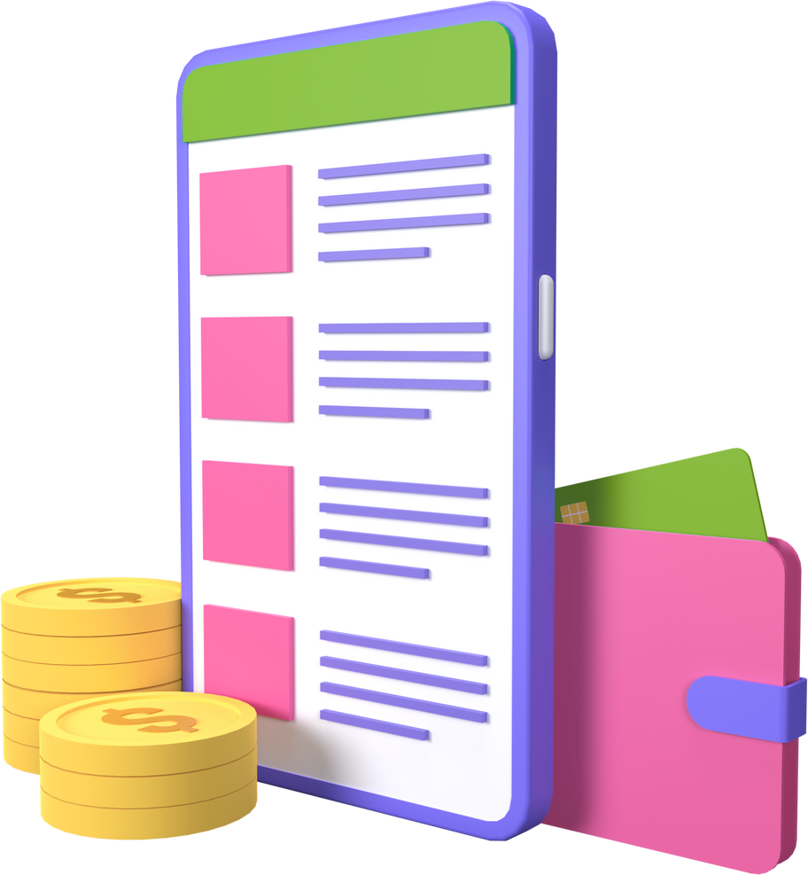
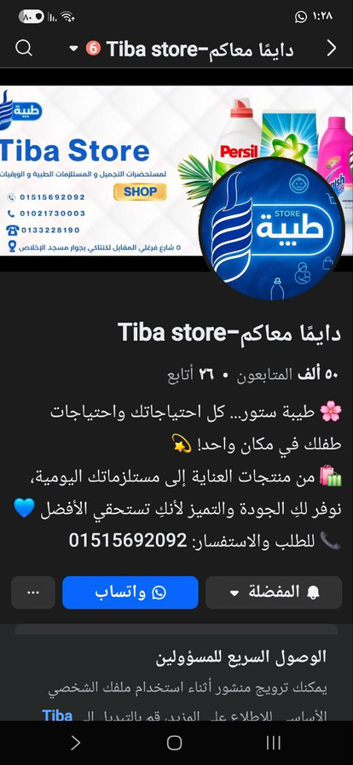

Marketing Channels Overview:
WhatsApp Business:
Used as a direct and personal communication channel, enabling customers to inquire about and order products easily and quickly.
Email Marketing:
A mailing list will be created to send exclusive offers and helpful content, aiming to enhance customer loyalty and encourage repeat purchases.
Social Media (Facebook, Instagram, TikTok):
These are the cornerstones of marketing campaigns, focusing on visual and interactive content such as Reels and short videos to showcase product usage and build an emotional connection with the audience.
Paid Advertising:
Through Google Ads and social media, we will reach potential customers based on their interests and digital behavior, ensuring increased awareness and sales within the local community.

Slide 7

Digital Marketing Plan
Internal Analysis (SWOT):
Strengths: Tayba Store stands out as the one-stop family store in Banha, offering beauty, cleaning, and baby care products all in one place.
Weaknesses: Low brand awareness outside of existing customers due to a heavy reliance on organic marketing.
External Analysis:Opportunities: The increasing activity of Banha residents on Facebook, Instagram, and TikTok presents strong opportunities for visual merchandising and direct engagement.
Threats: Growing competition from supermarkets and specialty online stores targeting the same demographics.
Target Audience:Mothers aged 25-45 seeking safe and reliable family products.
Young adults aged 18-30 seeking affordable beauty and personal care products with easy online ordering.

Slide 8
Objectives
Sell: Increase sales by 20% within three months across digital channels.
Serve: Improve customer satisfaction through faster response times and higher-quality service on WhatsApp and Telegram.
Speak: Boost brand awareness and reach 10,000 new followers on Facebook and Instagram.
Save: Reduce customer acquisition cost (CAC) by 15% through targeted campaigns.
Sizzle: Build a strong brand image as the best and most trusted local store serving the families of Banha.
Strategy
Positioning: “The local store that understands the needs of Banha families and offers everything they need in one place.”
Value Proposition: Reliable quality, reasonable prices, and convenient and fast digital service.
Targeting: Focusing on families in Banha through the most active local social media platforms (Facebook, WhatsApp, Telegram).
Tone of Voice: Friendly, reliable, approachable, and emphasizing the family aspect.

Slide 9



Tactics
Social Media:
Facebook and Instagram: Post visual content (Reels, photos, tips).
TikTok: Short videos showcasing products in an interactive way.
WhatsApp Business: For direct communication and order placement.
Telegram: A dedicated group to display each product with its updated price.
Email: Sending exclusive offers and educational content to members.
Paid Advertising: Through Facebook and Instagram to target Banha residents based on their interests and purchasing behavior.

Slide 10
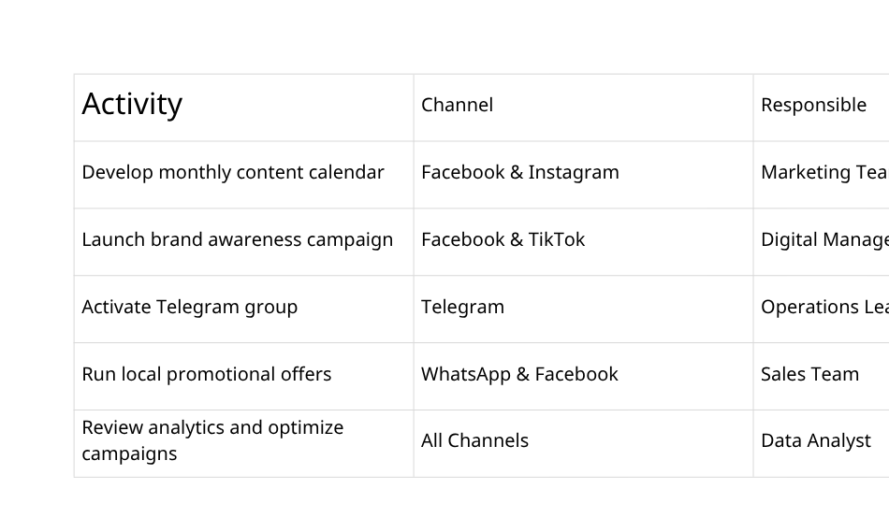
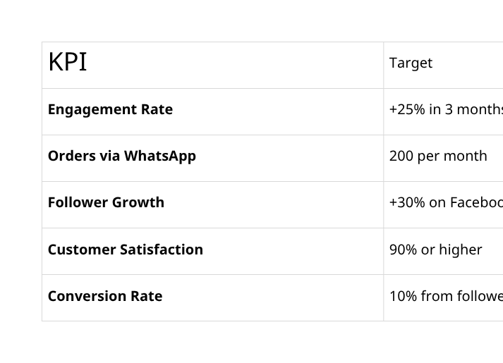

Slide 11

Situational Analysis
Overview:
Tayba Store is a local store in Banha specializing in beauty, baby care, and household cleaning products. The store operates under the "One-Stop Family Shop" concept, bringing together all the family's needs in one place.
Strengths:
Diverse product categories in one store.
Growing trust from local customers in product quality.
Weaknesses:
Limited brand awareness outside Banha.
Heavy reliance on organic marketing only.
Opportunities:
Strong social media presence among Banha residents (Facebook, Instagram, TikTok).
Potential to attract new customers through targeted digital marketing and paid advertising.
Threats:
Competition from large and specialized online stores.
Changing consumer behavior towards app-based shopping.

Slide 12


2. Objectives (Where do we want to go?)
Increase brand awareness by 40% within 3 months in Banha city.
Increase new customers by 25% within 6 months through digital channels.
Reach 10,000 followers on Facebook and Instagram by the end of the campaign.
Achieve a 30% increase in sales through WhatsApp and Telegram.
3. Tactics (Platform Implementation)
Facebook and Instagram: Post 3 types of content weekly (Crucible, Reels, Q&A).
Rotate 5 ad designs weekly to test for best performance (CPC and CTR).
TikTok: Post 3 trending videos weekly using broad and niche hashtags.
WhatsApp Business: Send automated personalized offers and update daily statuses
with quick offers and customer feedback.

Slide 13
4. Strategy
Focusing on a diverse content strategy across all platforms while maintaining the unified brand identity of "Tayba Store – The Best for Your Family Every Day."
Content Hubs (3Cs):
Beauty Products: Quick routines, beauty tips, and "Get the Look."
Cleaning Products: Practical tips, real-life experiences, and before/after results.
Baby Products: Educational content and ideas for mothers ("Mom Hacks").
Influencer Plan:
Collaborating monthly with 5 to 8 local influencers (micro-influencers) from Banha with 5,000–50,000 followers to achieve genuine engagement and credibility.
Platform Focus:
TikTok: 80% entertainment content / 20% marketing using trends and challenges.
Instagram: Publishing visual content with engagement through stories, polls, and paid ads for mothers.
Facebook: Building community and increasing conversions through offers and links to WhatsApp.
User Content Initiative (UGC): Launching a monthly challenge to encourage customers to share product review videos using a specific hashtag, with a prize of a £300 voucher.

Slide 14
5. Implementation (Action – Practical Application of the Plan)
Create a weekly content calendar with daily monitoring of trending topics.
Conduct A/B testing to evaluate ads among mothers and youth demographics (video versus still images).
Provide influencers with discount codes and direct purchase links.
Manually publish content on each platform, adding the Tayba Store logo to the videos.

Slide 15
6. Control – KPIs & Measurement
Weekly Monitoring:
Measure engagement and daily page growth rate.
Adjust content if the engagement rate falls below 5% for three consecutive days.
Monthly Reports:
Compare actual growth to the target number of followers (10,000).
Calculate cost per follower.
Analyze the top 10 performing posts to replicate their performance.
Key Performance Indicators (KPIs): Engagement Rate
WhatsApp and Telegram conversion rates.
Click-Through Rate (CTR).
Follower growth and monthly sales.

Slide 16
Email Marketing Strategy
1. Segmentation:
The email list will be divided into three main categories to tailor messages and offers to each customer's needs:
Beauty and skincare products / Household cleaning products / Baby care products
This segmentation aims to increase engagement and conversion rates by tailoring content and offers to specific interests.
2. Welcome Series:
A welcome series of three automated messages will be sent immediately upon a new customer's subscription:
Message 1: An introduction to the Tayba Store brand and its values ​​of quality and trust.
Message 2: Highlighting the unique selling proposition (USP) of being a comprehensive family store in Banha.
Message 3: Offering a 10% welcome discount on the first purchase via WhatsApp or Telegram.
3. Abandoned Cart Recovery:
If a customer leaves their items in the cart without completing the purchase, a follow-up message will be sent after 6 hours containing a reminder of the items and possibly a small incentive (discount or free delivery) to encourage them to complete the order.

Slide 17

Current Situation Analysis
1. Project Overview:
Tayba Store is a local store in Banha specializing in beauty, cleaning, and baby care products, under the slogan "The One-Stop Family Store – The Best for Your Family Every Day."
The store relies on digital marketing via WhatsApp, Facebook, Instagram, TikTok, and Telegram to reach its local audience, with a particular focus on direct communication and offering customized deals for Banha families.
2. Internal Analysis:
Strengths:
Provides a convenient shopping experience through direct communication via social media.
A wide variety of products that meet the needs of all family members (beauty, cleaning, and baby care).
High local trust from existing customers in product quality and after-sales service.
Weaknesses:
Low brand awareness outside of regular customers in Banha.
Reliance on organic marketing efforts without consistent digital campaigns.

Slide 18



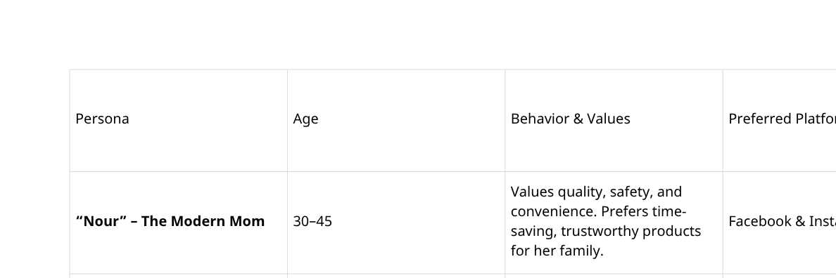
3. External Analysis:
Opportunities:
Increased activity of Banha residents on social media platforms (especially Facebook and Instagram).
Growing demand for safe and guaranteed local products.
Potential to expand digital presence through paid advertising and email marketing.
Threats:
Competition from major online retailers specializing in beauty and personal care products.
Changing consumer behavior towards purchasing from popular retail apps.
Customer sensitivity to price in the face of intense competition.

Slide 19
5. Competitor Analysis:
Competitive Gap:
Most competitors focus solely on price, while Tayba Store distinguishes itself by emphasizing value, quality, and convenience in local shopping.
Learning from Competitors: Stores with the highest engagement rely on user-generated content and simple contests.
Practical Conclusion:
Tayba Store should focus on a mix of professional and authentic content through local influencers to demonstrate credibility.
6. Digital Performance Audit:
Video content (Reels/TikTok) achieves the highest engagement rates compared to static posts.
Most Engaged Audience: Mothers and young people within Greater Banha.
Top Performing Channels: WhatsApp, Facebook, and Instagram.
7. Key Challenge:
Transitioning from limited local awareness to expanding the customer base in Banha while preserving the family-oriented nature and local identity, through a strong content plan and targeted paid campaigns.

Slide 20
Moment of
Questions and answers

